Slide 1
Major Project On
“Analysis of Different Electrical Components and Properties of a RLC circuit using Machine Learning ”
Under the guidance of: By:
Mr. Jatin Ayush Gangwar 16/IEC/009
Shashank Singh 16/IEC/057
Rishabh Rathi 16/IEC/033

Slide 2
CONTENTS
Motivation
Introduction
Project Overview
Process
Algorithms Used
Formula Used
Result
Applications of ML
Advantages of ML
Disadvantages of ML
Future Scope
Conclusion

Slide 3
MOTIVATION
Circuit designing is essential but complicated. A lot of calculation goes in finding the desired value of different electrical components required in the circuit which can be very time consuming.
Machine Learning is a hot topic nowadays through which computers can learn and predict output from experience without external programming.
Using ML algorithms one can easily find the desired value of different components based on different properties for optimum efficiency of circuits.

Slide 4
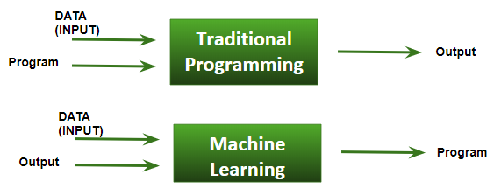
INTRODUCTION
WHAT IS MACHINE LEARNING ?
Machine learning is an application of artificial intelligence (AI) that provides systems the ability to automatically learn and improve from experience without being explicitly programmed. Machine learning focuses on the development of computer programs that can access data and use it to learn for themselves.

Slide 5
INTRODUCTION (cont)
WHY MACHINE LEARNING ?
Develop system that can automatically adapt and customize themselves to individual user.
Discover new knowledge from large databases.
Ability to mimic human and replace certain monotonous task which required some intelligence.
Develop system that are too difficult and expensive to construct manually because they require specific detailed skills or knowledge tuned to a specific task.

Slide 6
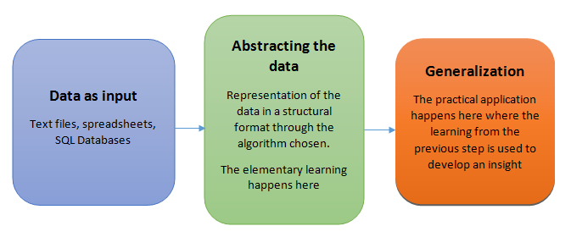
INTRODUCTION (cont)
How exactly do we teach machines?
Teaching the machines involve a structural process where every stage builds a better version of the machine. For simplification purpose, the process of teaching machines can broken down into 3 parts:

Slide 7
INTRODUCTION (cont)
Basic steps used in Machine Learning
There are 5 basic steps used to perform a machine learning task:
Collecting data: Be it the raw data from excel, access, text files etc., this step (gathering past data) forms the foundation of the future learning. The better the variety, density and volume of relevant data, better the learning prospects for the machine becomes.
2. Preparing the data: Any analytical process thrives on the quality of the data used. One needs to spend time determining the quality of data and then taking steps for fixing issues such as missing data and treatment of outliers. Exploratory analysis is perhaps one method to study the nuances of the data in details thereby burgeoning the nutritional content of the data.

Slide 8
INTRODUCTION (cont)
Training a model: This step involves choosing the appropriate algorithm and representation of data in the form of the model. The cleaned data is split into two parts – train and test (proportion depending on the prerequisites); the first part (training data) is used for developing the model. The second part (test data), is used as a reference.
Evaluating the model: To test the accuracy, the second part of the data (holdout / test data) is used. This step determines the precision in the choice of the algorithm based on the outcome. A better test to check accuracy of model is to see its performance on data which was not used at all during model build.
Improving the performance: This step might involve choosing a different model altogether or introducing more variables to augment the efficiency. That’s why significant amount of time needs to be spent in data collection and preparation.

Slide 9
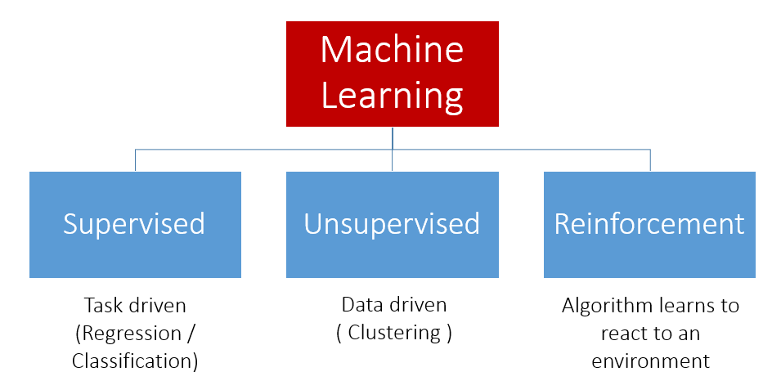
INTRODUCTION (cont)
The Types of Machine Learning Algorithms

Slide 10
PROJECT OVERVIEW
We used 3 different datasets (Resistance, Capacitance, Inductance) for this project.
Created ML models using Simple Linear Regression and Ridge Regression .
Codes for the models were written using Python3 language on Spyder (Anaconda3) software.
The models were tested and trained using the above mentioned datasets for predicting values of components.

Slide 11
PROCESS
Datasets are procured.
Datasets are divided into testing and training datasets.
ML models are created using ML algorithms and trained using training data.
ML models are tested using testing data through which accuracy of model is calculated.
When accuracy of model is greater than threshold then model is ready for predicting output.
Required output is calculated.
flow chart.docx

Slide 12
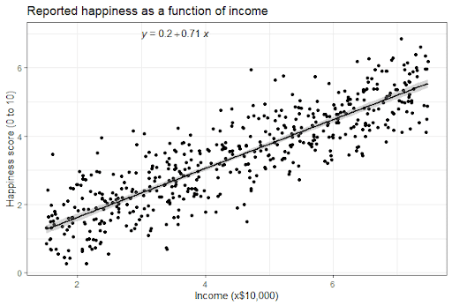
AlGORITHMS USED
1. Simple linear regression- is a linear regression model with a single explanatory variable. That is, it concerns two-dimensional sample points with one independent variable and one dependent variable (conventionally, the x and y coordinates in a Cartesian coordinate system) and finds a linear function (a non-vertical straight line) that, as accurately as possible, predicts the dependent variable values as a function of the independent variables. The adjective simple refers to the fact that the outcome variable is related to a single predictor.

Slide 13
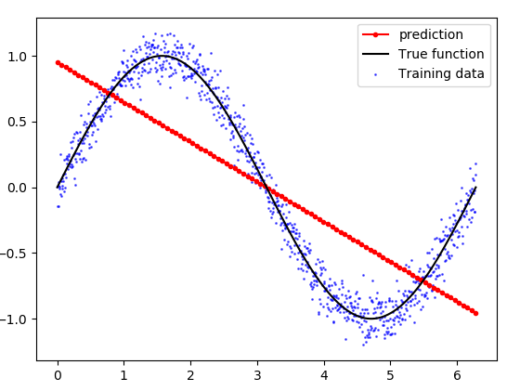
ALGORITHMS USED (cont)
2. Ridge Regression-is a technique for analyzing multiple regression data that suffer from multicollinearity. When multicollinearity occurs, least squares estimates are unbiased, but their variances are large so they may be far from the true value. By adding a degree of bias to the regression estimates, ridge regression reduces the standard errors. It is hoped that the net effect will be to give estimates that are more reliable.

Slide 14
FORMULA USED
Here L → Inductance
l → Wire Length
w → Wire Width
t → Wire Thickness

Slide 15
RESULT
Following results are obtained in this project:
In the Resistance code, the ML model can predict desired value with up to 95% accuracy.
In the Capacitance code, the ML model can predict desired value with up to 99% accuracy.
In the Inductance code, the ML model can predict desired value with up to 99% accuracy.

Slide 16

APPLICATIONS OF ML
Banking / Telecom / Retail
Identify:
Prospective customers
Dissatisfied customers
Good customers
Bad payers
Obtain:
More effective advertising
Less credit risk
Fewer fraud
Decreased churn rate

Slide 17

APPLICATIONS (cont)
2. Biomedical / Biometrics
Medicine:
Screening
Diagnosis and prognosis
Drug discovery
Security:
Face recognition
Signature / fingerprint / iris verification
DNA fingerprinting

Slide 18
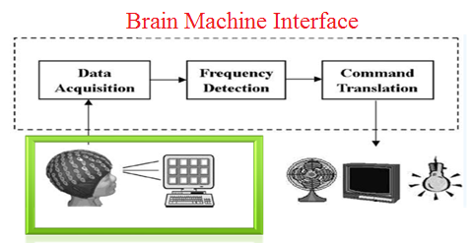
APPLICATIONS (cont)
3. Computer / Internet
Computer interfaces:
Troubleshooting wizards
Handwriting and speech
Brain waves
Internet
Hit ranking
Spam filtering
Text categorization
Text translation
Recommendation

Slide 19
ADVANTAGES OF ML
Easily identifies trends and patterns.
No human intervention needed (automation).
Continuous Improvement.
Handling multi-dimensional and multi-variety data.
Wide Applications.

Slide 20
DISADVANTAGES OF ML
Data Acquisition
Time and Resources
Interpretation of Results
High error-susceptibility

Slide 21
Future Scope
This project can be very helpful in designing much more complex circuits with many more circuit elements if good quality and large datasets can be procured and feeded to the Machine Learning Algorithms.
This project can also be used to design suitable circuit elements with respect to many different material properties and atmospheric conditions if a relationship can be established between them or good quality and large datasets can be obtained based on different variables.
These circuit elements can then be used to design desirable circuits depending on customer needs with optimum efficiency.

Slide 22
CONCLUSION
Design different electrical components such as Resistance, Capacitance and Inductance based on different material properties such as Wire Length, Width & Thickness(for capacitance & inductance) and Temperature(for resistance) using machine learning algorithms.
This project can be very useful to electrical circuit designing companies as it can learn from a large dataset and predict values for different components over a million possible values feeded by the user using machine learning.

Slide 23


